Slide 1
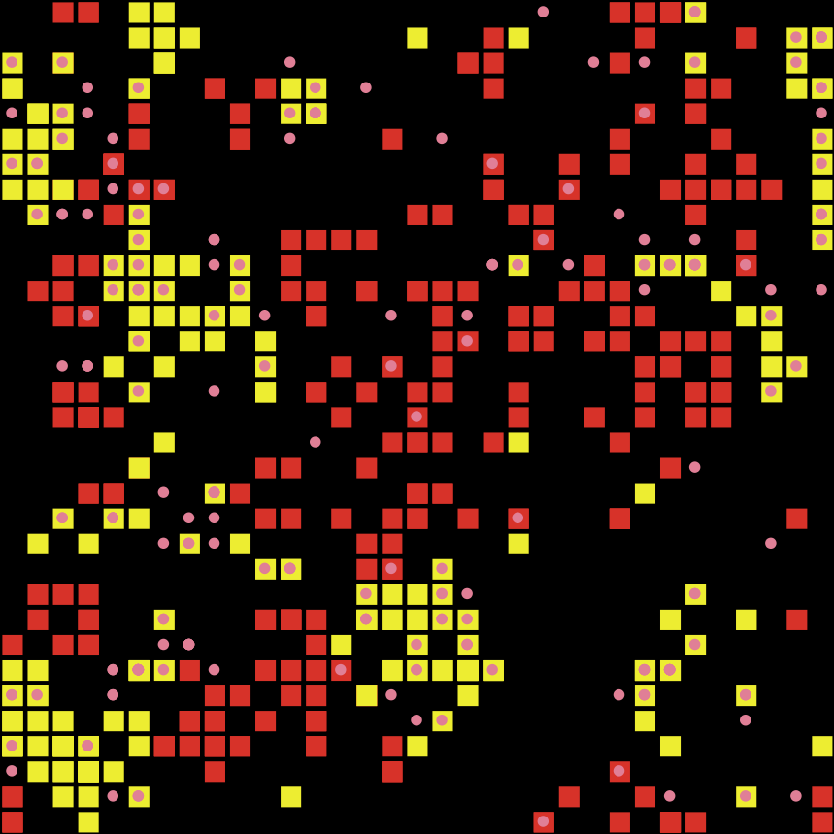
An Agent-Based Model of Disease-Induced Cannibalism
The Zombie Geoc-alypse
by Michael Culshaw-Maurer

Slide 2
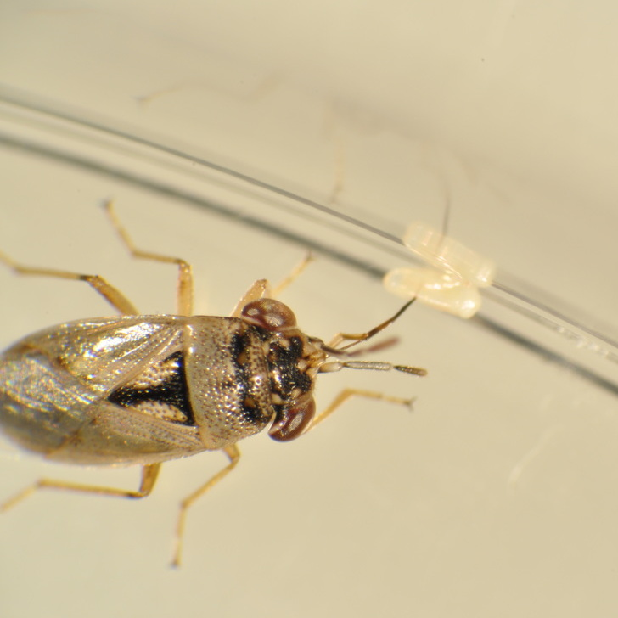
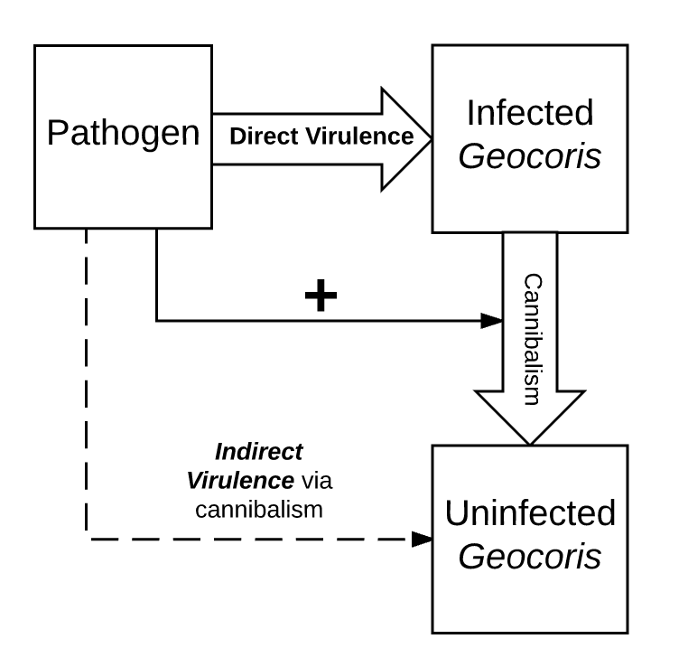
Outline
Geocoris pallens system: background and motivations
Theoretical stuff: disease and population dynamics
Agent-based model: structure and analysis

Slide 3
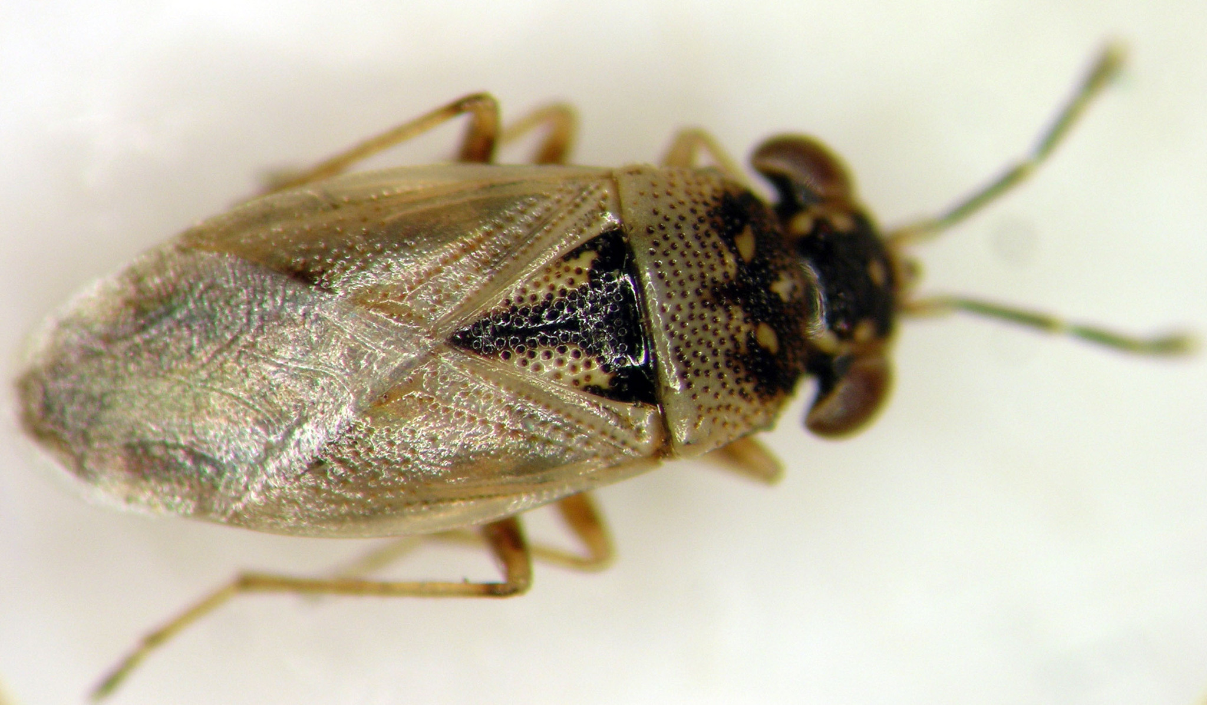
My Inspiration, My Muse
Geocoris pallens, the big-eyed bug
Generalist Hemipteran predator
Beneficial in cotton, alfalfa, vegetable systems
Exhibit density-dependent cannibalism
Poor test-takers:
Notes:
Females exhibit higher cannibalism when unmated or when they perceive conspecifics
Females cannot recognize their own eggs
Cannibalism appears to be dilution of risk of eating own offspring
Essentially shifts the cost-benefit of cannibalism

Slide 4
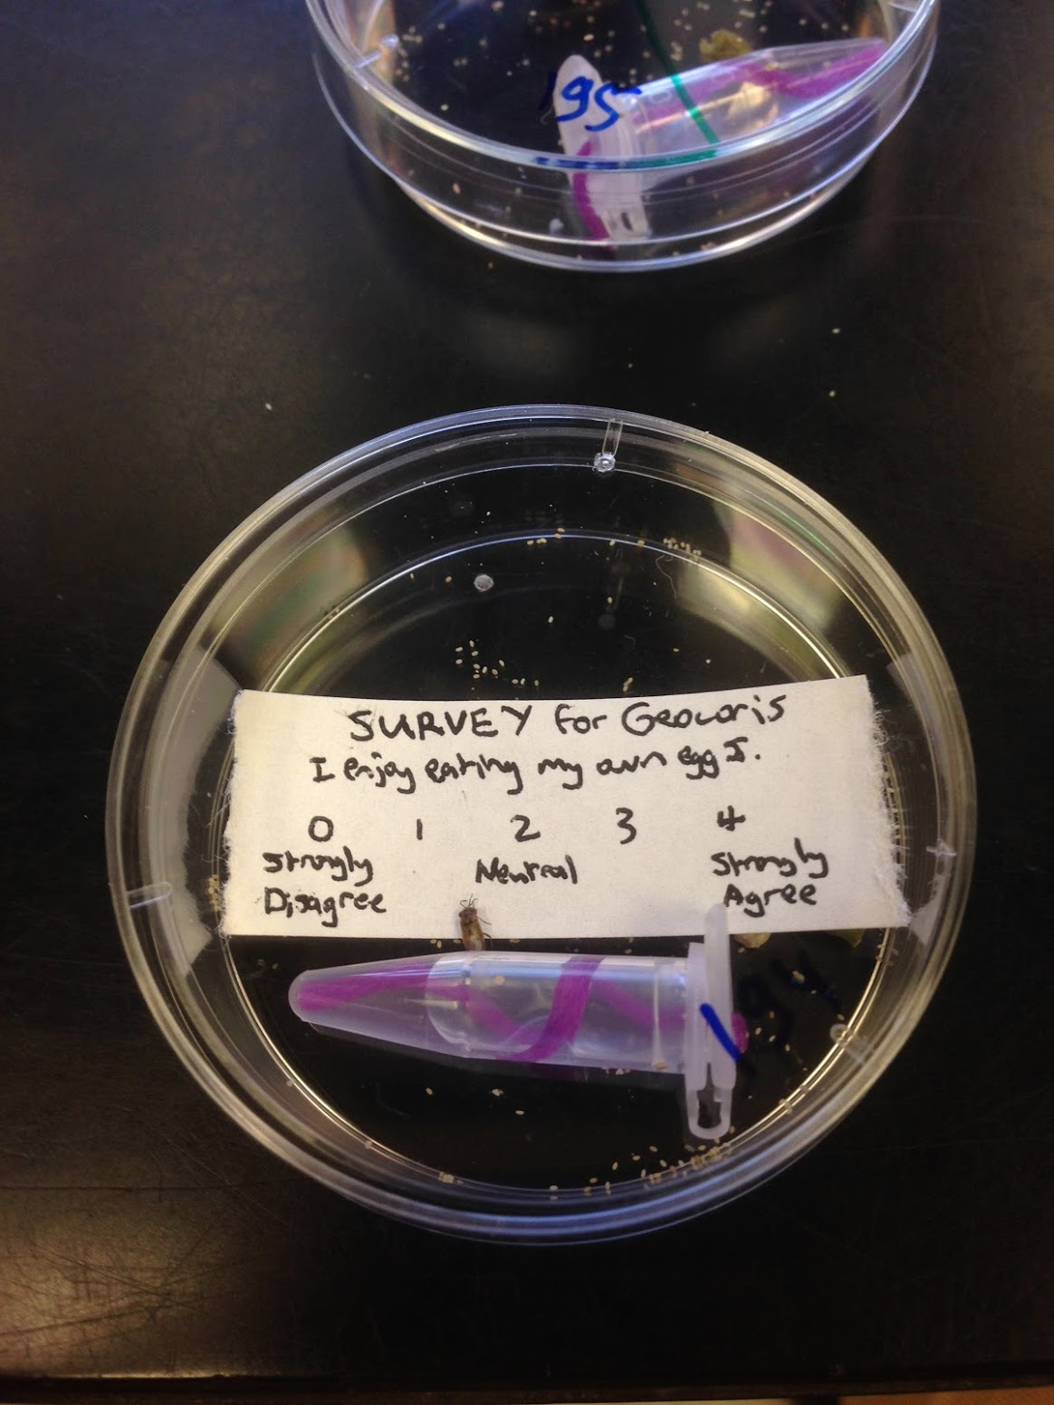

Slide 5
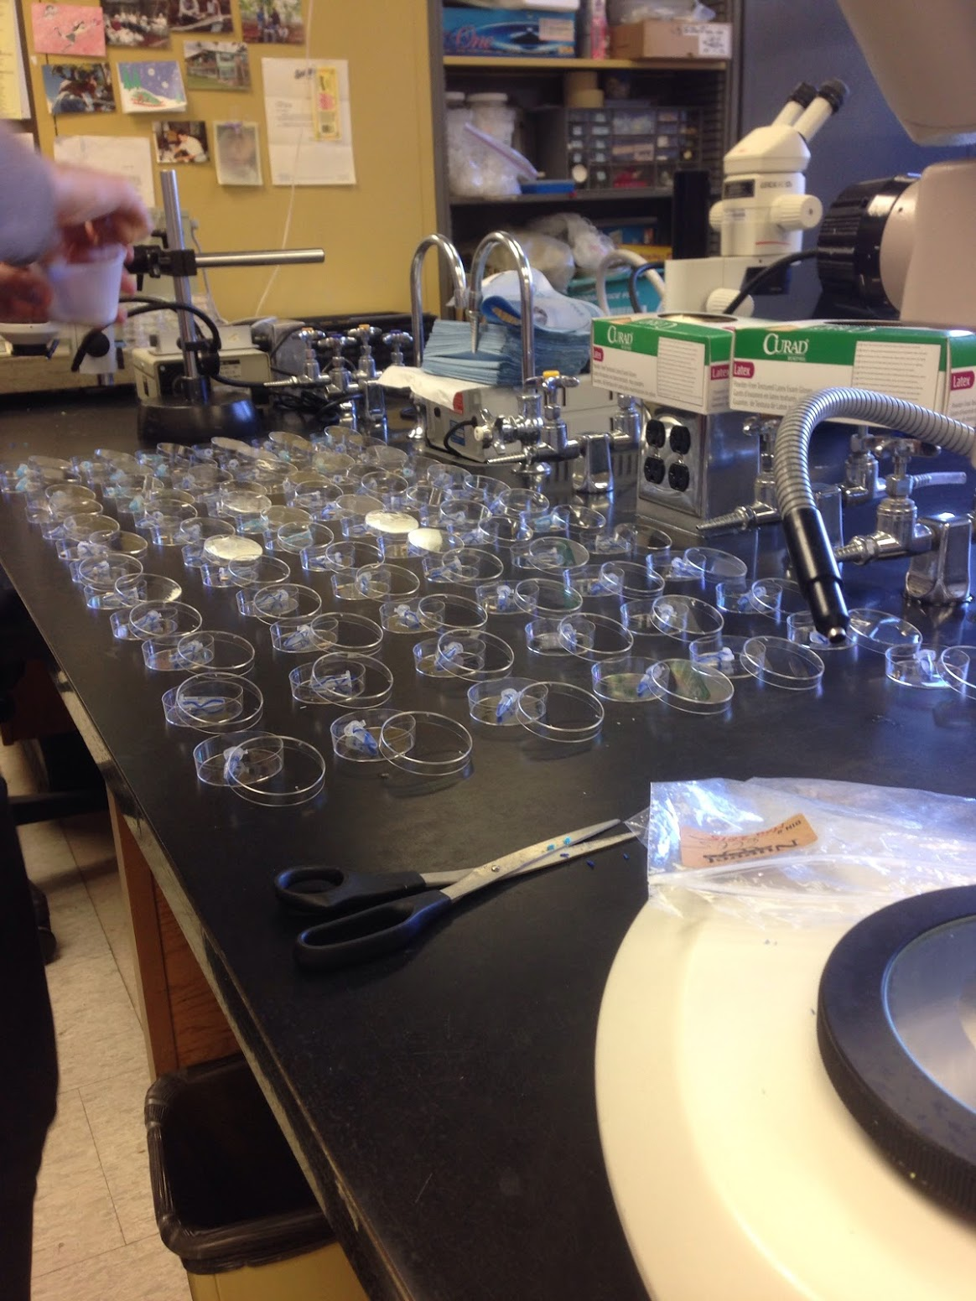
Cannibalism Assay
Females placed in Petri dishes
Given Ephestia eggs, green bean, sunflower seeds, water source
Females lay and cannibalize eggs
Visible chorion left behind
Notes:
We’ve since gotten rid of water source, grean bean provides enough

Slide 6
Geocoris Disease
In 2012-13, dramatic population collapses
Coincided with a spike in cannibalism expression
Population collapses spread geographically
Lab colonies also began to collapse
Several experiments to show transmission of cannibalism phenotype
Notes:
Feed a mashed-up cannibal to a non-cannibal and they’ll turn cannibalistic

Slide 7
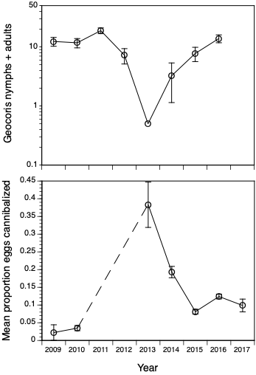
Populations and Cannibalism
Notes:
Data on populations is density/sweep sample, primarily from Westside
Cannibalism data

Slide 8
Cannibalism and Disease
Cannibalism is widespread, can have a range of effects on population dynamics
Frequently size/stage dependent
Common response to dietary stress
Disease commonly causes dietary stress
Previously thought that cannibalism typically reduced disease transmission
Notes:
Can regulate populations (Ricker model), cause cycles, dampen cycles caused by other D-D, bistability caused by benefits of reduced competition and increased energy intake
Asaf showed other dynamics

Slide 9
Disease-Induced Cannibalism
2 previous examples from literature: Tribolium beetles (Yan et al 1994) and Gammarus amphipods (Bunke et al 2015)
Potentially a more widespread phenomenon, prompting general theoretical exploration
Notes:
While the Geocoris system is what got me interested in these questions, I’m going to first address the more general phenomenon using a theoretical approach, and I’ll get to the Geocoris system later

Slide 10
Pathways of Virulence
Cannibalism
Host
Host
Notes:
Unfortunate thing about studying this concept is that you can’t really get an infected individual to NOT cannibalize

Slide 11

Space and Movement
What are the effects of movement and local interactions on the contributions of disease-induced cannibalism?
Is movement necessary for the indirect virulence pathway to occur?
Notes:
Space: for some, it’s the final frontier. For others, it’s their jam. For me, it’s Chapter 2.

Slide 12
Hypothesis on Movement
High movement
Low movement
Cannibalism
Host
Host
Notes:
High movement/well mixed increases cannibalistic effect on everyone
Low movement will mainly increase cannibalism within the infected group, whether consumption of own offspring or other nearby infected

Slide 13
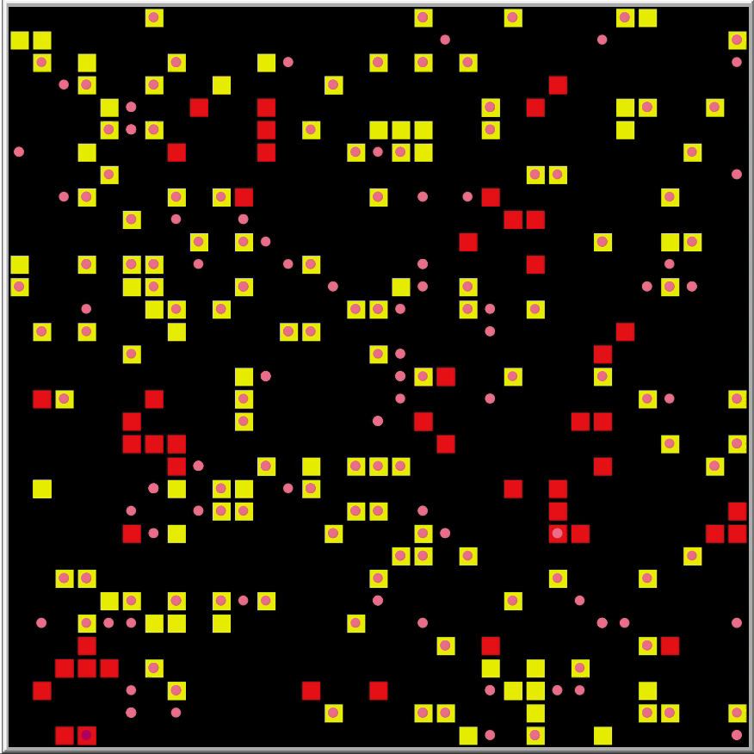
NetLogo Agent-Based Model
Discrete and spatially explicit agent-based model
Juveniles and adults
All interactions are localized
Allows for exploration of movement/spatial structure
Graphical Output (it’s pretty)
Notes:
Describe structure of NetLogo model

Slide 14
Global Sensitivity Analysis
Model has too many parameters for local sensitivity analysis
Lots of higher-order interactions
Good methods for global sensitivity analysis of stochastic ecological models: Harper et al 2011, Ecological Applications; Prowse et al 2016, Ecosphere
Notes:
Describe structure of NetLogo model

Slide 15
Workflow
Latin Hypercube subsampling of parameter space (10,000 samples)
Single simulation run with each parameter combination (10,000 time steps)
Random Forest analysis to get “importance measure” of each parameter for a given output
Notes:
Describe structure of NetLogo model

Slide 16
General Model Analysis
First sensitivity analysis with wide parameter ranges

Slide 17
General Model Analysis
First sensitivity analysis with wide parameter ranges

Slide 18
Next Steps
Repeat sensitivity analysis with parameter ranges specific to G. pallens
This will hopefully constrain the importance score of basic demographic parameters
Conduct in-silica experiments looking at specific scenarios pertinent to Geocoris populations
Notes:
Can the model produce a stable bimodal distribution of high and low cannibals, ie a mix of infected high cannibals and uninfected low cannibals?
Can the disease drive Geocoris populations to extremely low levels, including potential local extinction?
Does an external source of infection generate continued population suppression?
Can a relaxed virulence disease lead to a more homogenous distribution of cannibalism levels? ie high levels of infection but relaxed virulence?
Does a difference in site fidelity between uninfected and infected adults change the disease dynamics and the distribution of mortality?

Slide 19
Conclusions
mcmaurer.github.io
mjculshawmaurer@ucdavis.edu
ABMs are flexible, intuitive, and allow for modeling localized dynamics like cannibalism and disease transmission
LHS + stochastic simulations + RF is a powerful method for global sensitivity analysis of ecological ABMs
Disease can interact with cannibalism in complex ways
Thanks to: Jay Rosenheim, Sebastian Schreiber, Nicholas Booster, Tobias Mueller, Randall Kuffel, Yao-Hua Law, Peter Goodell, Treanna Pierce, Larry Godfrey, Tobin Northfield, Asaf Sadeh, Lupine Abernathy, Mako McInturf

Slide 20
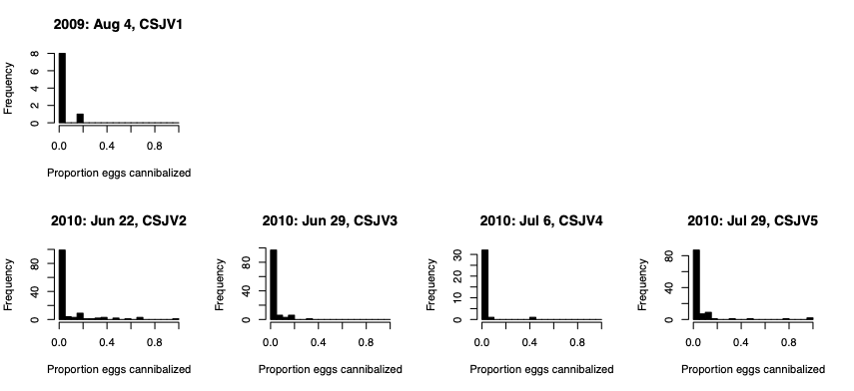
Populations and Cannibalism
Notes:
Data on populations is density/sweep sample, primarily from Westside
Cannibalism data

Slide 21
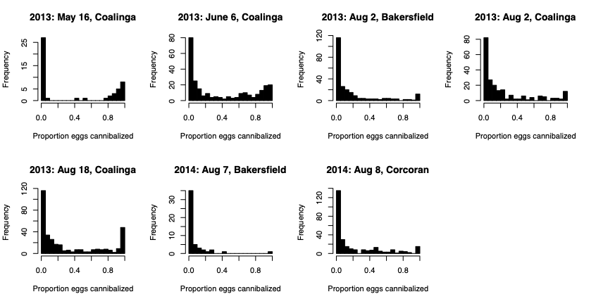
Populations and Cannibalism
Notes:
Data on populations is density/sweep sample, primarily from Westside
Cannibalism data

Slide 22
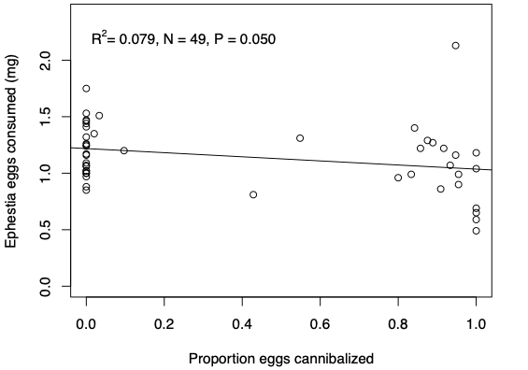
Hunger Games
Notes:
Cannibalistic females don’t increase consumption of heterospecific eggs
- could look at this for more kinds of eggs
Suggests general hunger may not be driving force

Slide 23
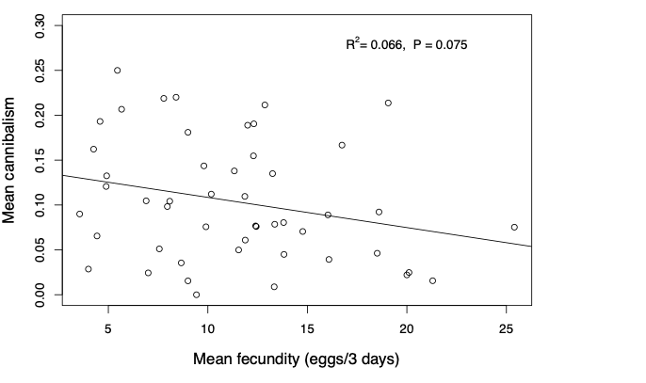
Hunger Games

Slide 24
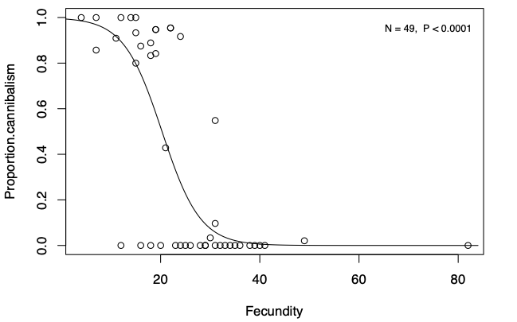
Hunger Games

